Slide 1



Programmable Packet Scheduling with a Single Queue
Zhuolong Yu
Chuheng Hu, Jingfeng Wu, Xiao Sun, Vladimir Braverman,
Mosharaf Chowdhury, Zhenhua Liu, Xin Jin
Notes:
Hello everyone, this is Zhuolong Yu from Johns Hopkins University. Today I’m glad to share our work, Programmable Packet Scheduling with a Single Queue.

Slide 2
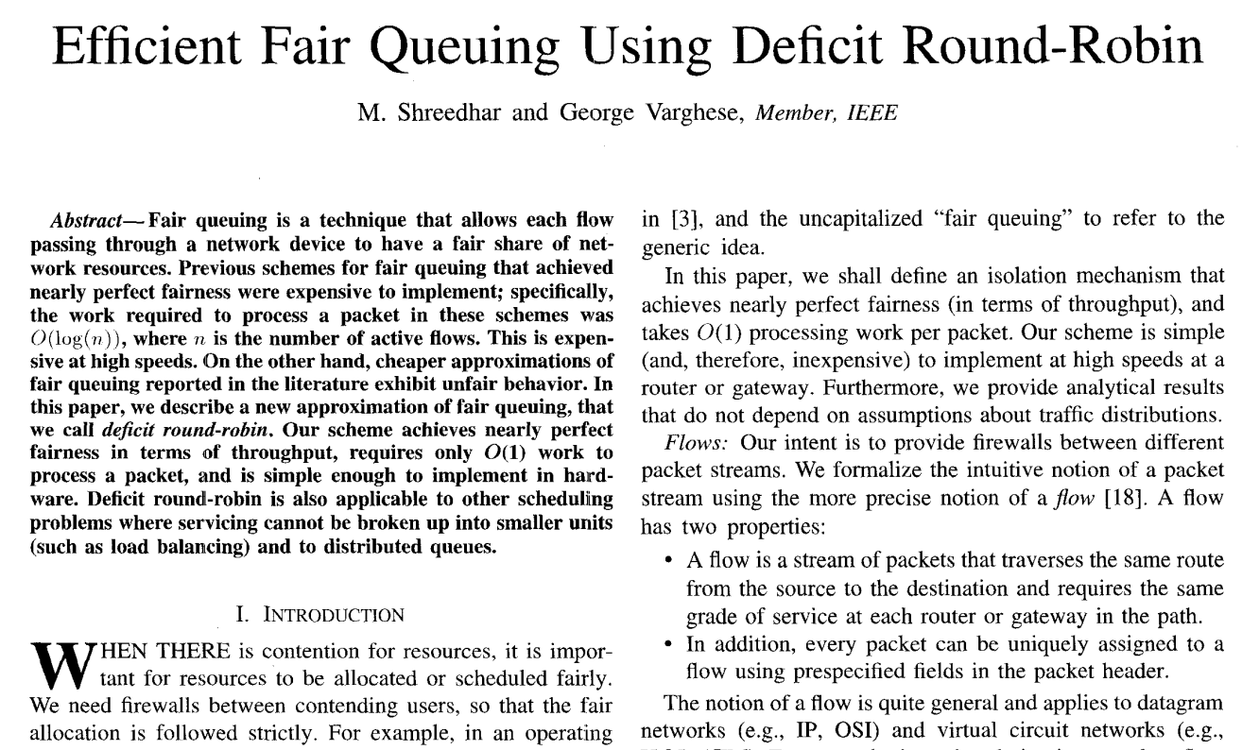
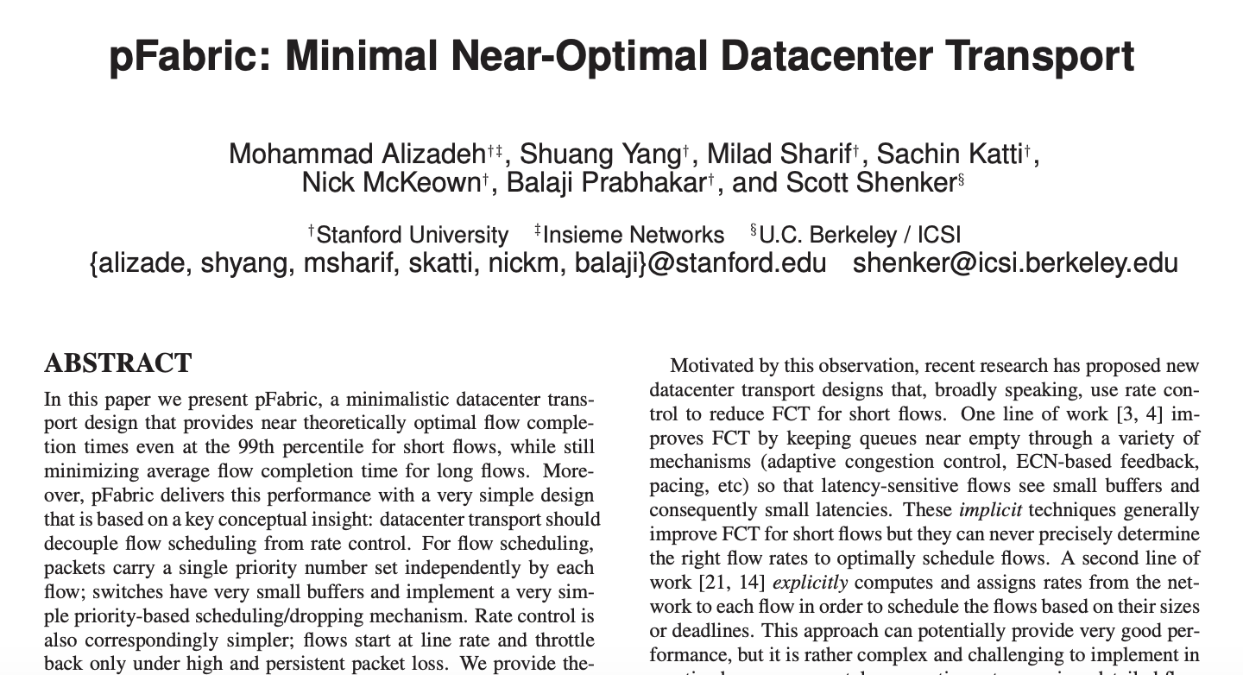
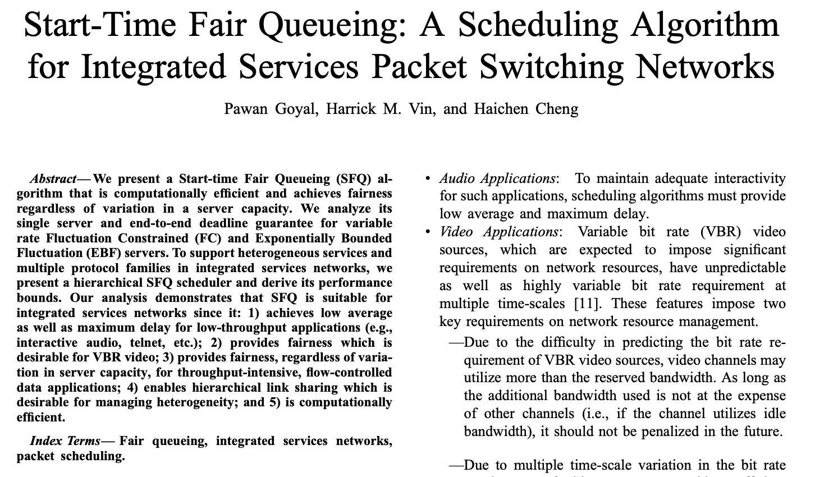
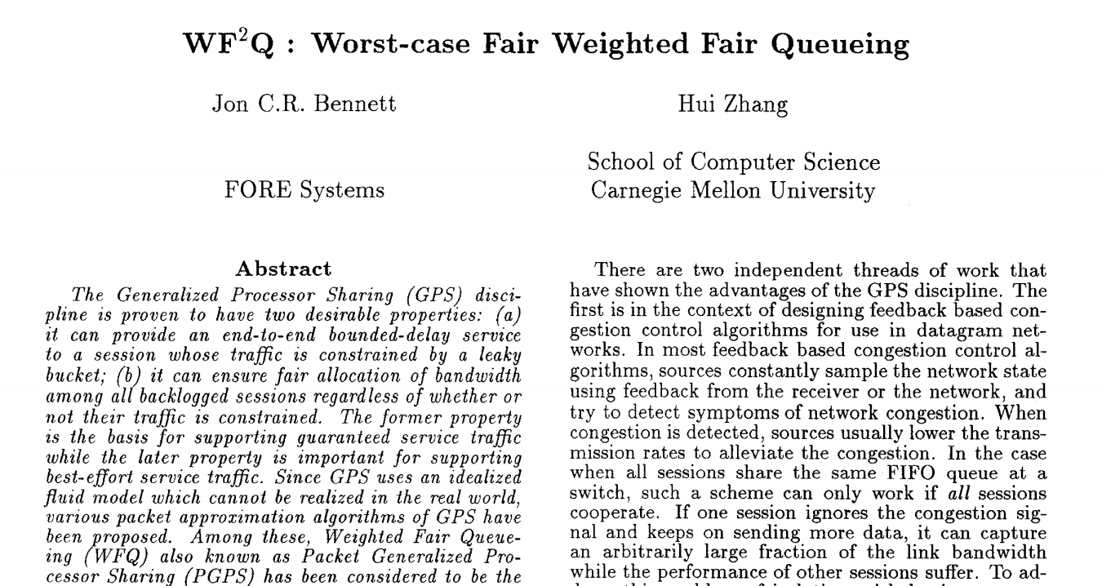
Packet Scheduling
Many packet scheduling algorithms have been designed for different properties
Lack of hardware support due to high cost to design and deploy switch ASICs
Notes:
There is a long history of designing packet scheduling algorithms. A lot of packet scheduling algorithms have been proposed for different objectives. But most of them are not deployed in practice for real network traffic.
(click) The main reason is that there is very limited hardware support for these algorithms due to high cost to design and deploy switch ASICs.

Slide 3
Programmable Packet Scheduling
Enables scheduling algorithms to be programmed into switch without changing the hardware design
FCFS
SRPT
STFQ
SRPT
……
……
Develop and deploy packet scheduling algorithms easily
Customize packet scheduling algorithms based on needs
Simplify the testing of new scheduling algorithms
Notes:
To address this problem, programmable packet scheduling emerged in recent years. The key idea is to decouple the packet scheduling algorithm from the switch ASICs.
It enables scheduling algorithms to be programmed into switch without changing the hardware design. And it brings three advantages: easy to develop, easy to customize, and easy to test.

Slide 4
Push-In First-Out (PIFO, SIGCOMM’16)
Rank computation
PIFO scheduler
pkt.rank
f = flow(pkt)
…
pkt.rank = get_rank(f, pkt)
9
6
3
2
Associate a rank with each packet and maintain a sorted queue to buffer packets
Newly arrived packets are inserted based on their ranks; packets are dequeued from the head
Different packet scheduling algorithms can be implemented on top of PIFO (e.g., SRPT, STFQ)
Notes:
PIFO is a popular approach proposed in recent years to realize programmable packet scheduling. The basic idea of PIFO is to associate a rank with each packet and maintain a sorted queue based on the rank to buffer packets.
The newly arrived packets are inserted based on their ranks, and the packets are dequeued from the head.
With that, different packet scheduling algorithms can be implemented on top of PIFO.

Slide 5
PIFO in practice
However, it is challenging to implement PIFO scheduler in practice, especially for switch ASICs
Deployability: require new ASIC implementation
Scalability: support ~1k flows
Notes:
However, despite its coolness. It is still challenging to implement PIFO scheduler in practice, especially for switch ASICs, because PIFO requires a new ASIC design and its design is not scalable enough.

Slide 6
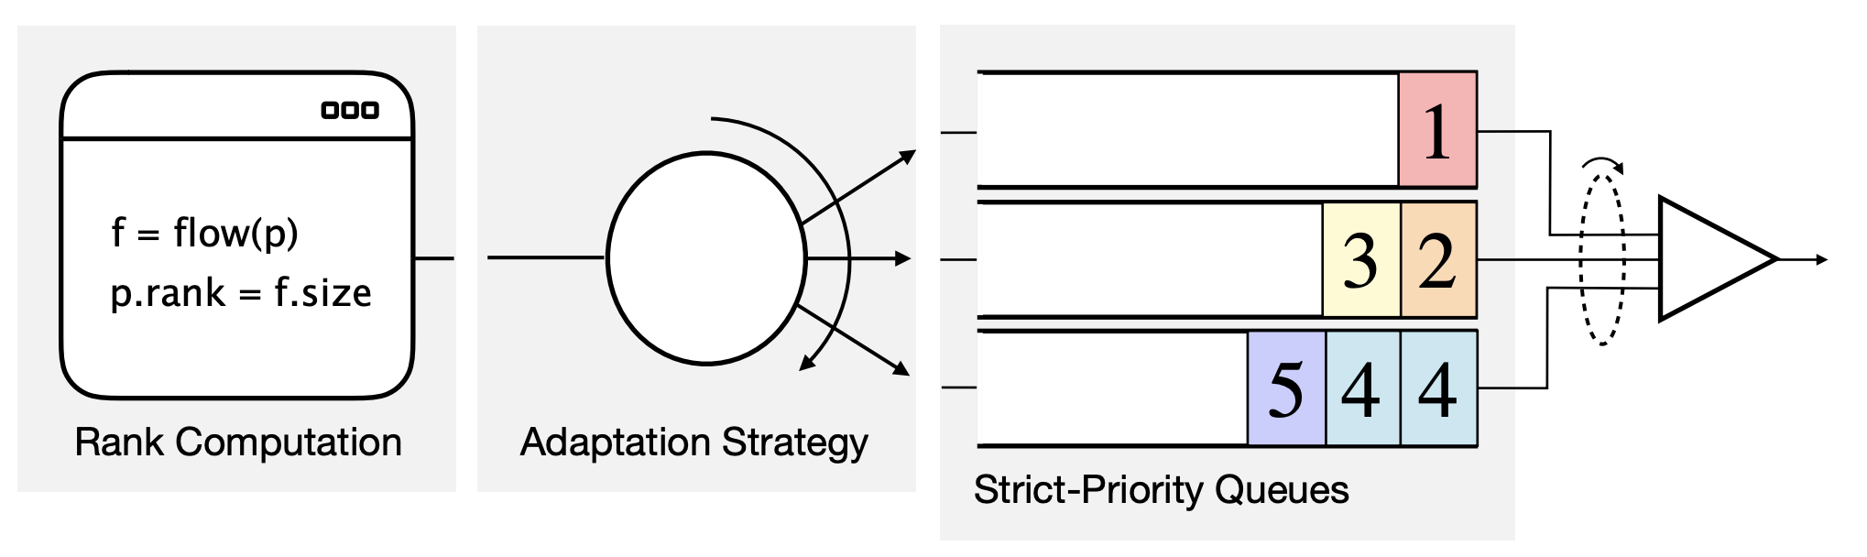
Approximation of PIFO: SP-PIFO (NSDI’20)
SP-PIFO is a deployable and scalable PIFO approximation
Map the ranks into a set of priorities and schedule the strict-priority queues
* This figure is from the SP-PIFO talk in NSDI 2020.
Require multiple strict-priority queues
Notes:
SP-PIFO is a very interesting work which approximates PIFO and can run on existing hardware. The basic idea is to map the ranks into a set of priorities, and then schedule the packets with a set of strict-priority queues. Their result shows they can approximate PIFO pretty well, however, the implementation of SP-PIFO requires multiple strict-priority queues. While in some cases, these hardware queues are precious, and should be used for other applications, like the performance isolation between tenants or applications for example.

Slide 7
Programmable Packet Scheduling
What is the minimal number of queues
to achieve programmable packet scheduling?
(on existing hardware)
Notes:
So we ask a question, what is the minimal number of queues to achieve programmable packet scheduling on existing hardware.

Slide 8





Programmable Packet Scheduling
What does packet scheduling do?
Maintain the order
Drop the “right” set of packets
There are two trends in DCN: shallow buffer in the switches and fast-converging congestion control (e.g., HULL, Timely, Swift)
Notes:
To answer that question, let’s first think about what does packet scheduling do. In some sense, we can consider that it’s doing two jobs: maintaining an order for the packets in the buffer, and dropping the “right” set of packets when the buffer is full.
(click) We observe that there are two trends in data center networking: shallow buffer in the switches, and the fast converging congestion control algorithms at endhosts.
Both of them are critical to the performance of data center networks.
(click) With these trends, we argue that dropping the “right” set of packets is more important for packet scheduling. For example, when there are some elephant flows competing with mice flows on one link, dropping the packets of elephant flows is more important than the dequeue order of the packets (click).

Slide 9
AIFO (Admission-In First-Out)
What is the “right” set of packets to drop?
Ideally we want to drop the same set of packets as PIFO
Notes:
Based on the intuition, we propose our approach called AIFO, Admission-In First-Out solution. So what is the right set of packets to drop.
(click) PIFO is a very optimized approach always putting the high priority packets to the front. So ideally we want to drop the same set of packets as PIFO.

Slide 10
AIFO (Admission-In First-Out)
What is the “right” set of packets to drop?
Ideally we want to drop the same set of packets as PIFO
FIFO
2
1
2
5
4
1
2
5
4
1
FIFO
PIFO
2
1
2
5
4
1
2
2
1
1
PIFO
rank<3?
AIFO
2
1
2
5
4
1
2
1
2
1
FIFO
Notes:
In this example, we have six packets coming.
(click) With FIFO, the first four packets get into the queue, and the last two packets get dropped when the queue is full.
(click) With PIFO, the low priority packets get dropped when the queue is full.
(click) For AIFO, if there is an oracle telling you to drop the right packets, for example here, if someone tell you to drop the packets with rank smaller than 3,
(click) then the admitted packet set is the same as PIFO.

Slide 11
AIFO Design
Ideally we want to drop the same set of packets as PIFO
rank<3?
AIFO
2
1
2
5
4
1
2
1
2
1
FIFO
AIFO uses admission control to achieve the goal
Uses only one FIFO queue
Drops packets based on their ranks
Drops packets even when the queue has room (e.g., packet 4 and 5)
Notes:
So our idea is to use admission control to approximate PIFO. In such a way, we only need one queue. AIFO’s admission control will drop packets based on their ranks and drop packets even when the queue has room.

Slide 12
AIFO Design
AIFO’s admission control consists of temporal component and “spatial” component
Temporal component
“Spatial” component
Packets are treated differently at a different “time”
Given the same “time”, different packets are treated differently
drop
admit
3
3
2
1
3
1
drop
admit
3
3
2
1
1
3
2
1
Notes:
Now, we show how we achieve the admission control. Our admission control consists of two components, the temporal component and the spatial component respectively.
(click) The temporal component means the packets with the same rank are treated differently at a different time. For example, when a packet with rank 3 comes, if the queue is almost empty, then the packet is admitted; if the queue is almost full, then the packet is rejected.
(click) The spatial component means that at a same time, different packets are treated differently. The queue is same full here, the packet with rank 3 still cannot get in, but a packet with rank 1 will be admitted.

Slide 13
AIFO Design
AIFO’s admission control consists of temporal component and “spatial” component
Temporal component
“Spatial” component
Discrepancy between arrival rate and departure rate
Relative rank of the arriving packet
queue.len() growing means arrival rate > departure rate
queue.len() decaying means arrival rate < departure rate
Use a sliding window (W) to track the ranks
Use quantile* to express the relative rank
*W.quantile(p): given packet p, return the number/percentile of packets with smaller rank than p in W.
Notes:
At a high level, the temporal component is to handle the discrepancy between arrival rate and departure rate. And the spatial component tries to capture the relative rank of the arriving packet.
(click) Our admission control uses the queue length as an indicator. When the queue length grows, it means the arrival rate is larger, when it decreases, it means the departure rate is larger.
(click) For the spatial component, we use a sliding window to track the ranks, and we use quantile to express the relative rank.
(click) The quantile here means for a given rank, how many values inside the window is smaller than the given rank. We will show how to compute the quantile in the data plane later.

Slide 14

AIFO Design
AIFO’s admission control consists of temporal component and “spatial” component
Temporal component
“Spatial” component
Quantile of the packet rank in the sliding window: W.quantile(pkt)
Queue length: c
Queue size: C
Admission control condition:
$$W.quantile\left(pkt\right)>\frac{C−c}{(1−k)C} ?drop:admit$$
Notes:
For the temporal component, we use the queue length and the queue size to capture the discrepancy of arrival rate and departure rate.
For the spatial component, we compute the quantile of the packet rank in the sliding window.
(click) We combine these two components into a single condition. And we use it to decide whether to admit or drop a packet.

Slide 15
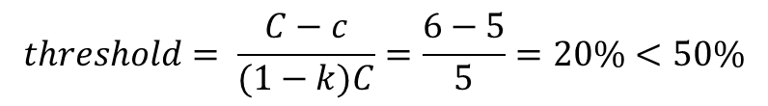
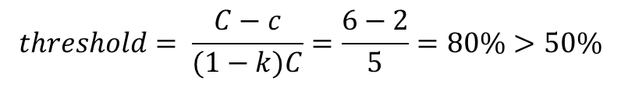
AIFO Design
Example: when a packet with quantile=50% comes
$$threshold= \frac{C−c}{(1−k)C}=\frac{6−2}{5}=80\%>50\%$$
$$threshold= \frac{C−c}{(1−k)C}=\frac{6−5}{5}=20\%<50\%$$
admit
drop
pkt.quantile = 50%
k=1/6, C=6, c=2
pkt.quantile = 50%
k=1/6, C=6, c=5
(a) When the queue length is 2
(b) When the queue length is 5
Notes:
Without getting into much detail, we give an example here to show how AIFO works. Here, we have a packet coming, assume the quantile of its rank is 50 percent. When the queue length is two,
(click) we can compute the threshold is 80 percent, which is larger than the quantile,
(click) so the packet is admitted.
(click) However, in the right figure, if the queue length is 5,
(click) then the threshold is smaller than the quantile
(click) as a result, the packet is dropped.

Slide 16
AIFO Design
How to compute W.quantile(pkt) ?
i: 0
i: 4
i: 8
i: 12
i: 1
i: 5
i: 9
i: 13
window slides
i: 2
i: 6
i: 10
i: 14
head
i: 3
i: 7
i: 11
i: 15
head
stage 1
stage 2
stage 3
stage 4
window on data plane
Notes:
Now we show how we compute the quantile. We use a sliding window to record a set of packets and compute the quantile with the sliding window. However, it is very difficult to maintain a plain sliding window on switch ASICs.
(click) In practice, we use registers in the switches to store the ranks and each register corresponds to one cell in the sliding window. Each stage in the switch pipeline can have multiple cells to store the ranks.

Slide 17
AIFO Design
How to compute W.quantile(pkt) ?
Head
i: 0
r: 2
i: 4
r: 9
i: 8
r: 1
i: 12
r: 7
pkt.index: 4
pkt.rank: 5
i: 1
r: 7
i: 5
r: 2
i: 9
r: 3
i: 13
r: 28
Index
Tagger
Admission
Control
i: 2
r: 8
i: 6
r: 15
i: 10
r: 2
i: 14
r: 4
Sampler
i: 3
r: 9
i: 7
r: 6
i: 11
r: 8
i: 15
r: 25
Feed 1 packet into the window
for every n packets
stage 1
stage 2
stage 3
stage 4
Notes:
In front of the registers, we have an index tagger to maintain the index for the packets, and decide which index is the current head of the sliding window.
(click) here, we have a packet with rank 5, the index tagger gives index 4
(click) which means the head is at cell 4.
(click) We also have a sampler module, which feeds 1 packet into the window for every n packets, so that we can approximate a larger window with given resources.

Slide 18
AIFO Design
Update the r value at cell [pkt.index]
How to compute W.quantile(pkt) ?
Compare pkt.rank with the ranks (r) in each cell
update r = 5
i: 0
r: 2
i: 4
r: 9
i: 8
r: 1
i: 12
r: 7
Get quantile for the packet
Update the sliding window
i: 4
r: 9
pkt.index: 4
pkt.rank: 5
i: 1
r: 7
i: 5
r: 2
i: 9
r: 3
i: 13
r: 28
Index
Tagger
Admission
Control
i: 2
r: 8
i: 6
r: 15
i: 10
r: 2
i: 14
r: 4
Sampler
i: 3
r: 9
i: 7
r: 6
i: 11
r: 8
i: 15
r: 25
Smaller than pkt.rank
Larger than pkt.rank
stage 1
stage 2
stage 3
stage 4
Notes:
We compare the rank of the packet with the ranks in the sliding window and compute the quantile for the packet
(click) at the same time, we update the cell at the head of the sliding window.
In this way, we can maintain the sliding window in the data plane and get the quantile for each packet.

Slide 19
Evaluation
Testbed experiments
6.5 Tbps Barefoot Tofino switch
5 servers with an 8-core CPU and a 40G NIC
Comparison: FIFO, SP-PIFO
Workload: UDP, TCP
Large-scale simulations
Simulator: Netbench
Topology: 9 Leaf – 4 Spine – 144 Servers topology
Comparison: PIFO, PIEO, SP-PIFO, TCP, DCTCP, AFQ
Workload: Web search workload
Applications: SRPT, STFQ
Switch
40G
S₁
S₂
S₃
S₄
S₅
Notes:
We implemented AIFO on a barefoot Tofino switch. And we have performed both testbed experiments and large scale simulations.

Slide 20
Evaluation
How does AIFO work in a datacenter setup?
SRPT
STFQ
How does the parameters affect AIFO?
Parameter K
Queue length
Window length and sampling rate
Is the admitted packet set similar with PIFO?
How does AIFO work on hardware testbed?
What is AIFO’s resource consumption?
Notes:
We evaluate a wide range of aspects of AIFO

Slide 21
Evaluation
How does AIFO work in a datacenter setup?
SRPT
STFQ
How does the parameters affect AIFO?
Parameter K
Queue length
Window length and sampling rate
Is the admitted packet set similar with PIFO?
How does AIFO work on hardware testbed?
What is AIFO’s resource consumption?
Notes:
In this talk, I will only show some of the results. Please refer to our paper for more detailed results.

Slide 22
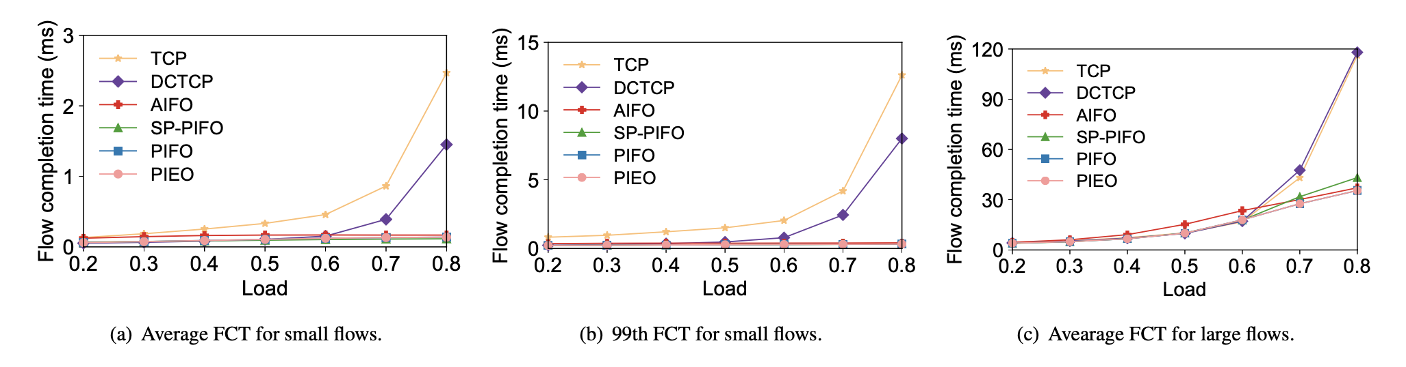
Evaluation
How does AIFO work in a datacenter setup
Close to the state-of-the-art solutions
Notes:
First we show how AIFO works in a data center setup. We compare AIFO with several several state of the art solutions. We change the traffic load and check the FCT for both small flows and large flows.
(click) According to these figures, AIFO has similar end to end performance compared with other state-of-the-art solutions.

Slide 23
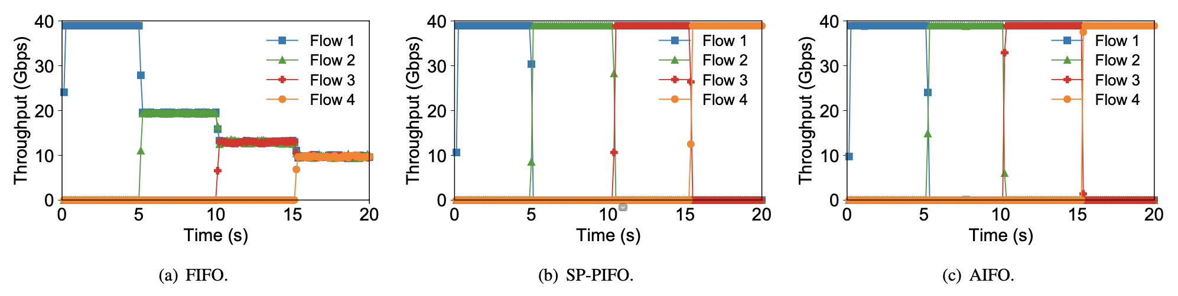
Evaluation
How does AIFO work on hardware testbed
4 senders send UDP traffic to 1 receiver, priority: f4>f3>f2>f1
High priority flow dominates the bandwidth
Notes:
Then we show how AIFO performs on a hardware testbed. We have 4 senders and 1 receiver running dpdk to send and receive packets. The 4 senders start one by one in every 5 seconds, and send UDP traffic to the receiver. And we give different priorities for these four flows, the later flow has higher priority than the earlier flow.
When we use FIFO, the bandwidth is evenly allocated to the four flows because it cannot distinguish these flows based on priorities.
(click) While SP-PIFO and AIFO can allocate the bandwidth for high priority flows, AIFO achieves this with only one queue.

Slide 24
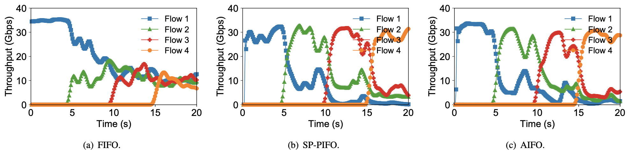
Evaluation
How does AIFO work on hardware testbed
4 senders send TCP traffic to 1 receiver, priority rank: 4>3>2>1
High priority flow dominates the bandwidth
Notes:
Here shows the TCP scenario. The setting is similar, we also give higher priorities for later flows.
And we can see a similar result that high priority flow dominates the bandwidth for SP-PIFO and AIFO.

Slide 25


Conclusion
AIFO is a programmable packet scheduling approach using only one queue
github.com/netx-repo/AIFO
zhuolong@cs.jhu.edu
Notes:
So in conclusion, we show we can use one single queue to build a programmable packet scheduling approach with existing hardware.

Slide 26
Thank you!
github.com/netx-repo/AIFO
zhuolong@cs.jhu.edu
Notes:
Thank you! I’m happy to take any questions.
Interesting stuff, quantile
Commodity switch,
Dropping packets, latency,
Story,
More animations,
Takeaway, flush the equation;
Preview the quantile, sampler
Sampler, which quantile is more important

Slide 27
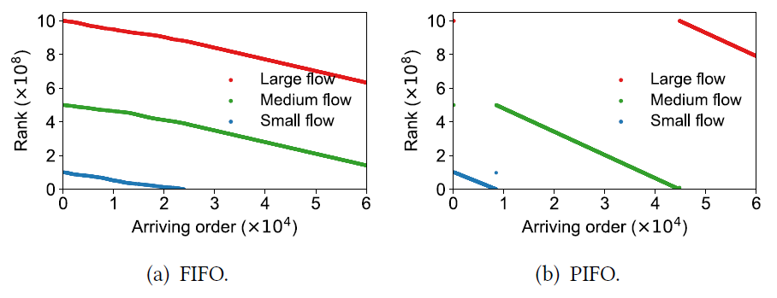
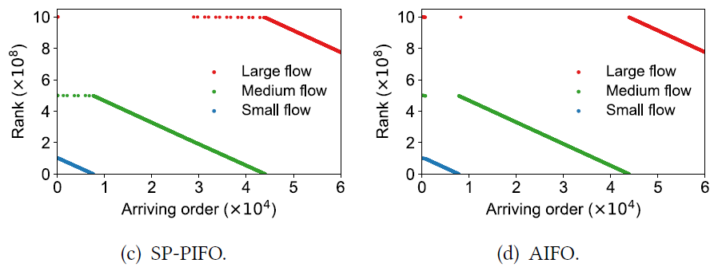
Evaluation
The admitted set is similar as PIFO
Three senders, each sends one flow to a receiver at the same time
The size of the three flows are 100MB (large), 50MB (medium) and 10MB (small), respectively
Running SRPT
The results logged at receiver side
Notes:
The second set of results we want to share is the admitted set. We use three senders, each sends one flow to a receiver, and the link between switch and the receiver is the bottleneck.
The flow size are 100, 50, and 10 MegaBytes respectively. They are all running SRPT, so the small flows should be prioritized.
We log the ranks of each received packet at the receiver side according to their arriving order.
In the figures, we can see that with FIFO, the three flows are processed evenly. While for PIFO, SP-PIFO and AIFO, the small flow is prioritized. However, AIFO is actually closer to PIFO than SP-PIFO in terms of arriving order, as we can see there are many scattered dots here in figure c.

Slide 28
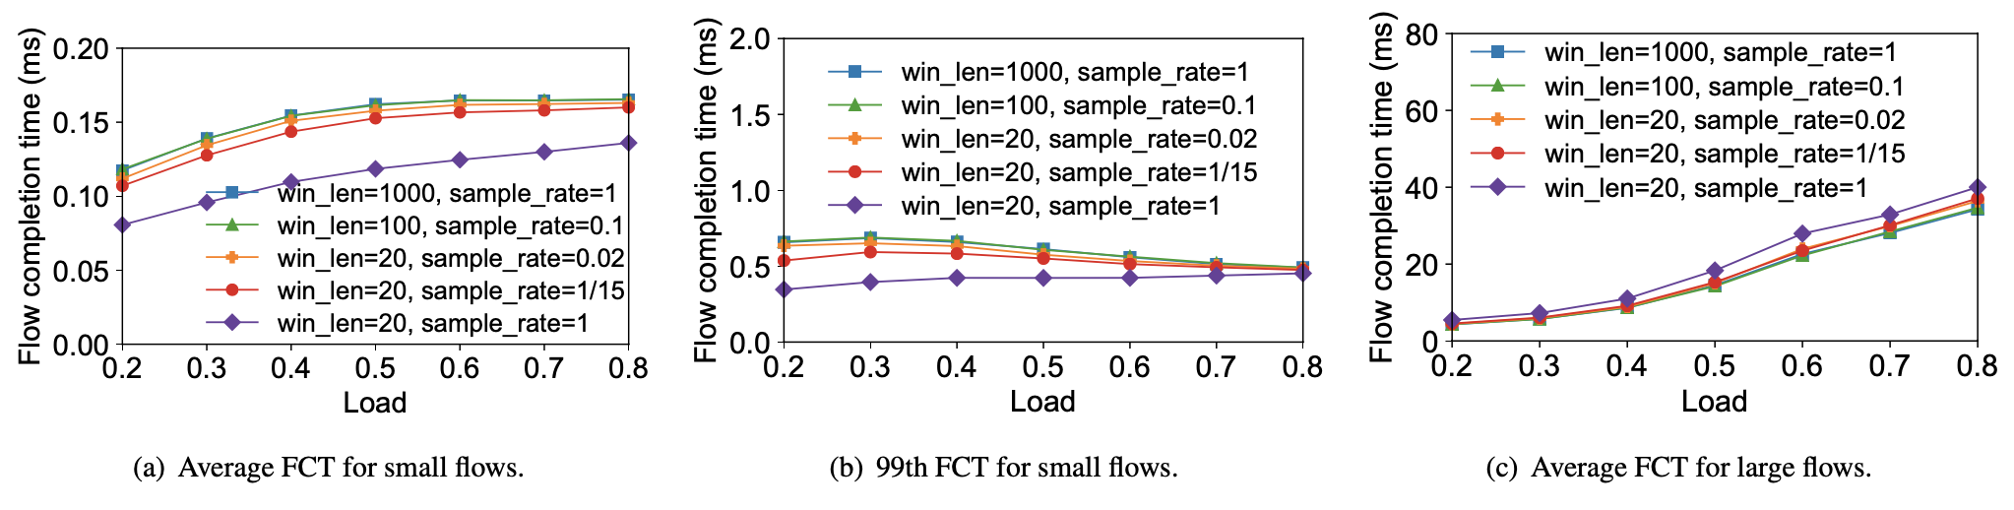
Evaluation
How does window length & sampling rate affect AIFO
Small window is usually enough
Small window + sampler approximates large window well

